Slide 1
pip install networkzero then WiFi: westpark-club

Slide 2
NetworkZero
Easy Network Discovery & Messaging
https://github.com/tjguk/networkzero
http://networkzero.readthedocs.io/

Slide 3

Notes:
Two years the club I help to run entered PiWars [trojan horse robot]

Slide 4
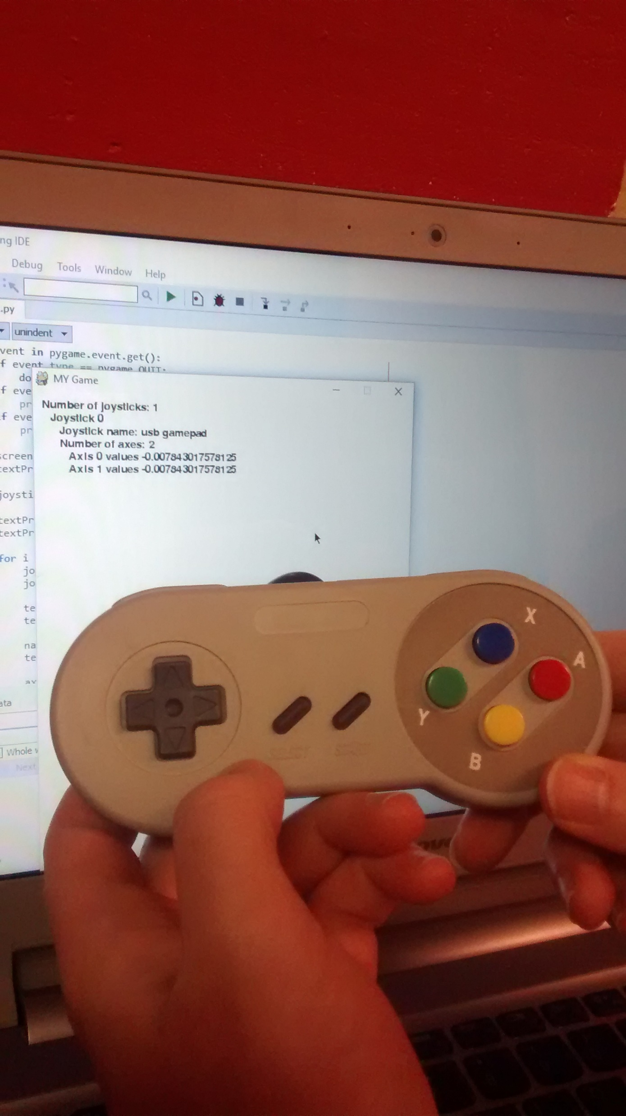
Notes:
We decided to remote control the robot via a controller connected to a laptop over WiFi [SNES controller connected to laptop]

Slide 5
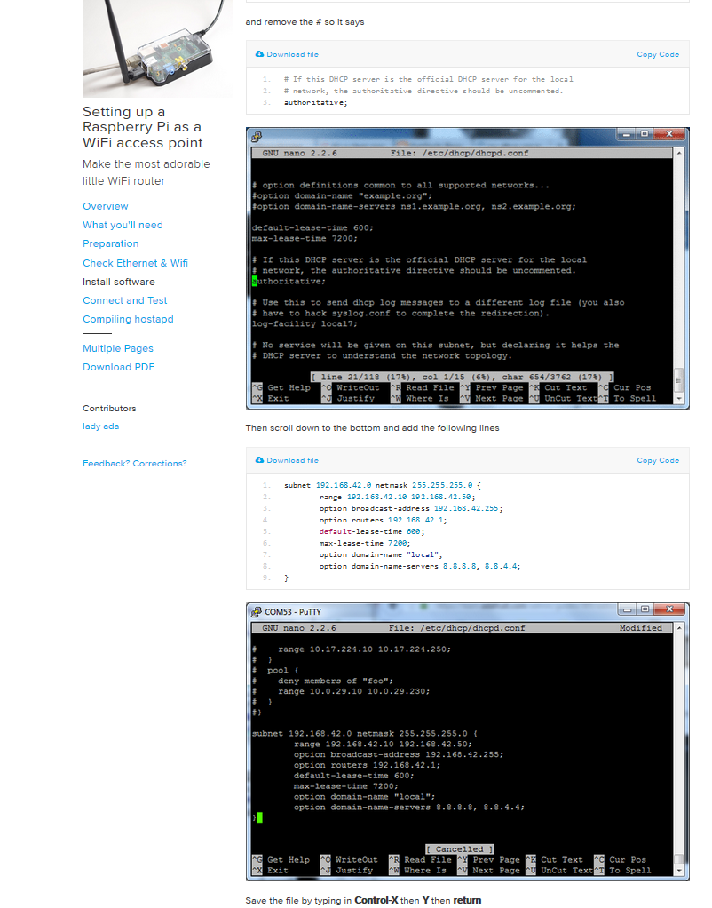
Notes:
We had to faff around setting the Pi inside the robot as an AP with a fixed IP [image of https://learn.adafruit.com/setting-up-a-raspberry-pi-as-a-wifi-access-point?view=all]

Slide 6
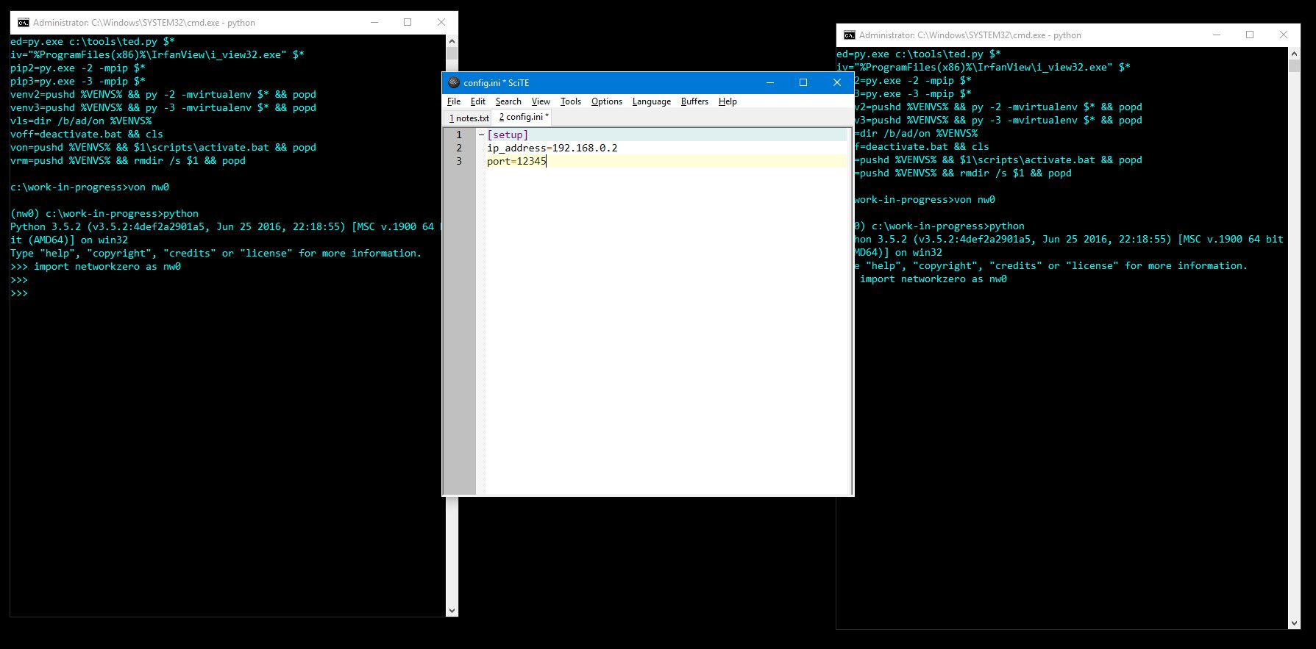
Notes:
But it worked... although when developing the controller code talking to localhost on my laptop I needed to mess around with the addresses / ports

Slide 7
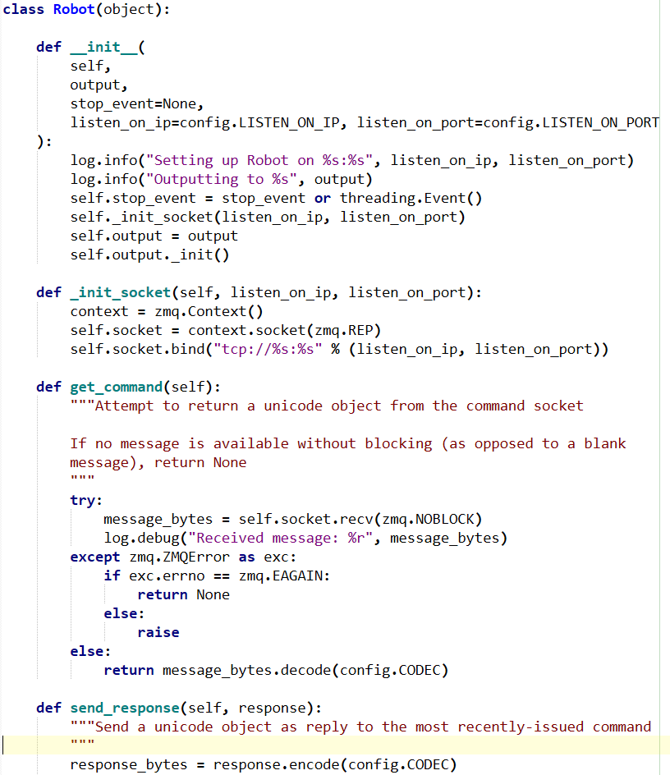
Notes:
I'd always wanted an excuse to use ZeroMQ... so we did that, with a very thin wrapper of my own to make it easier for the lads at the club

Slide 8
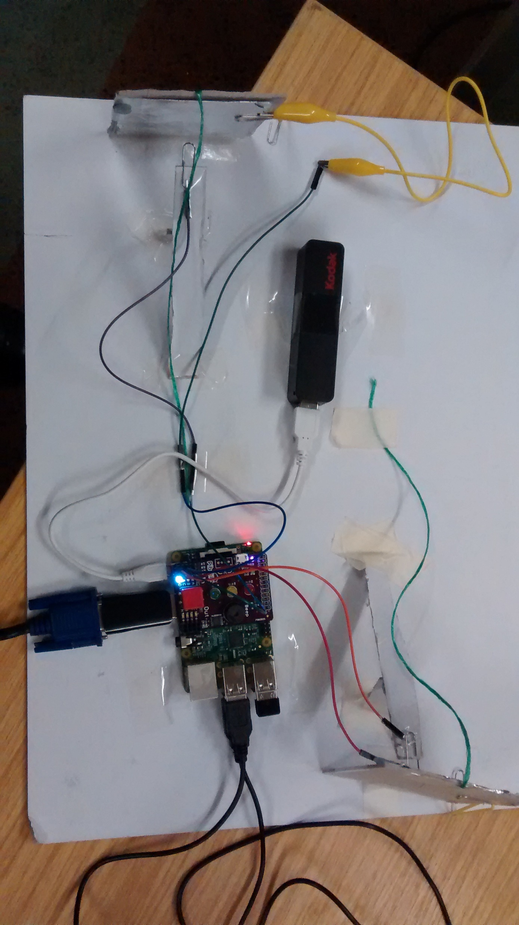
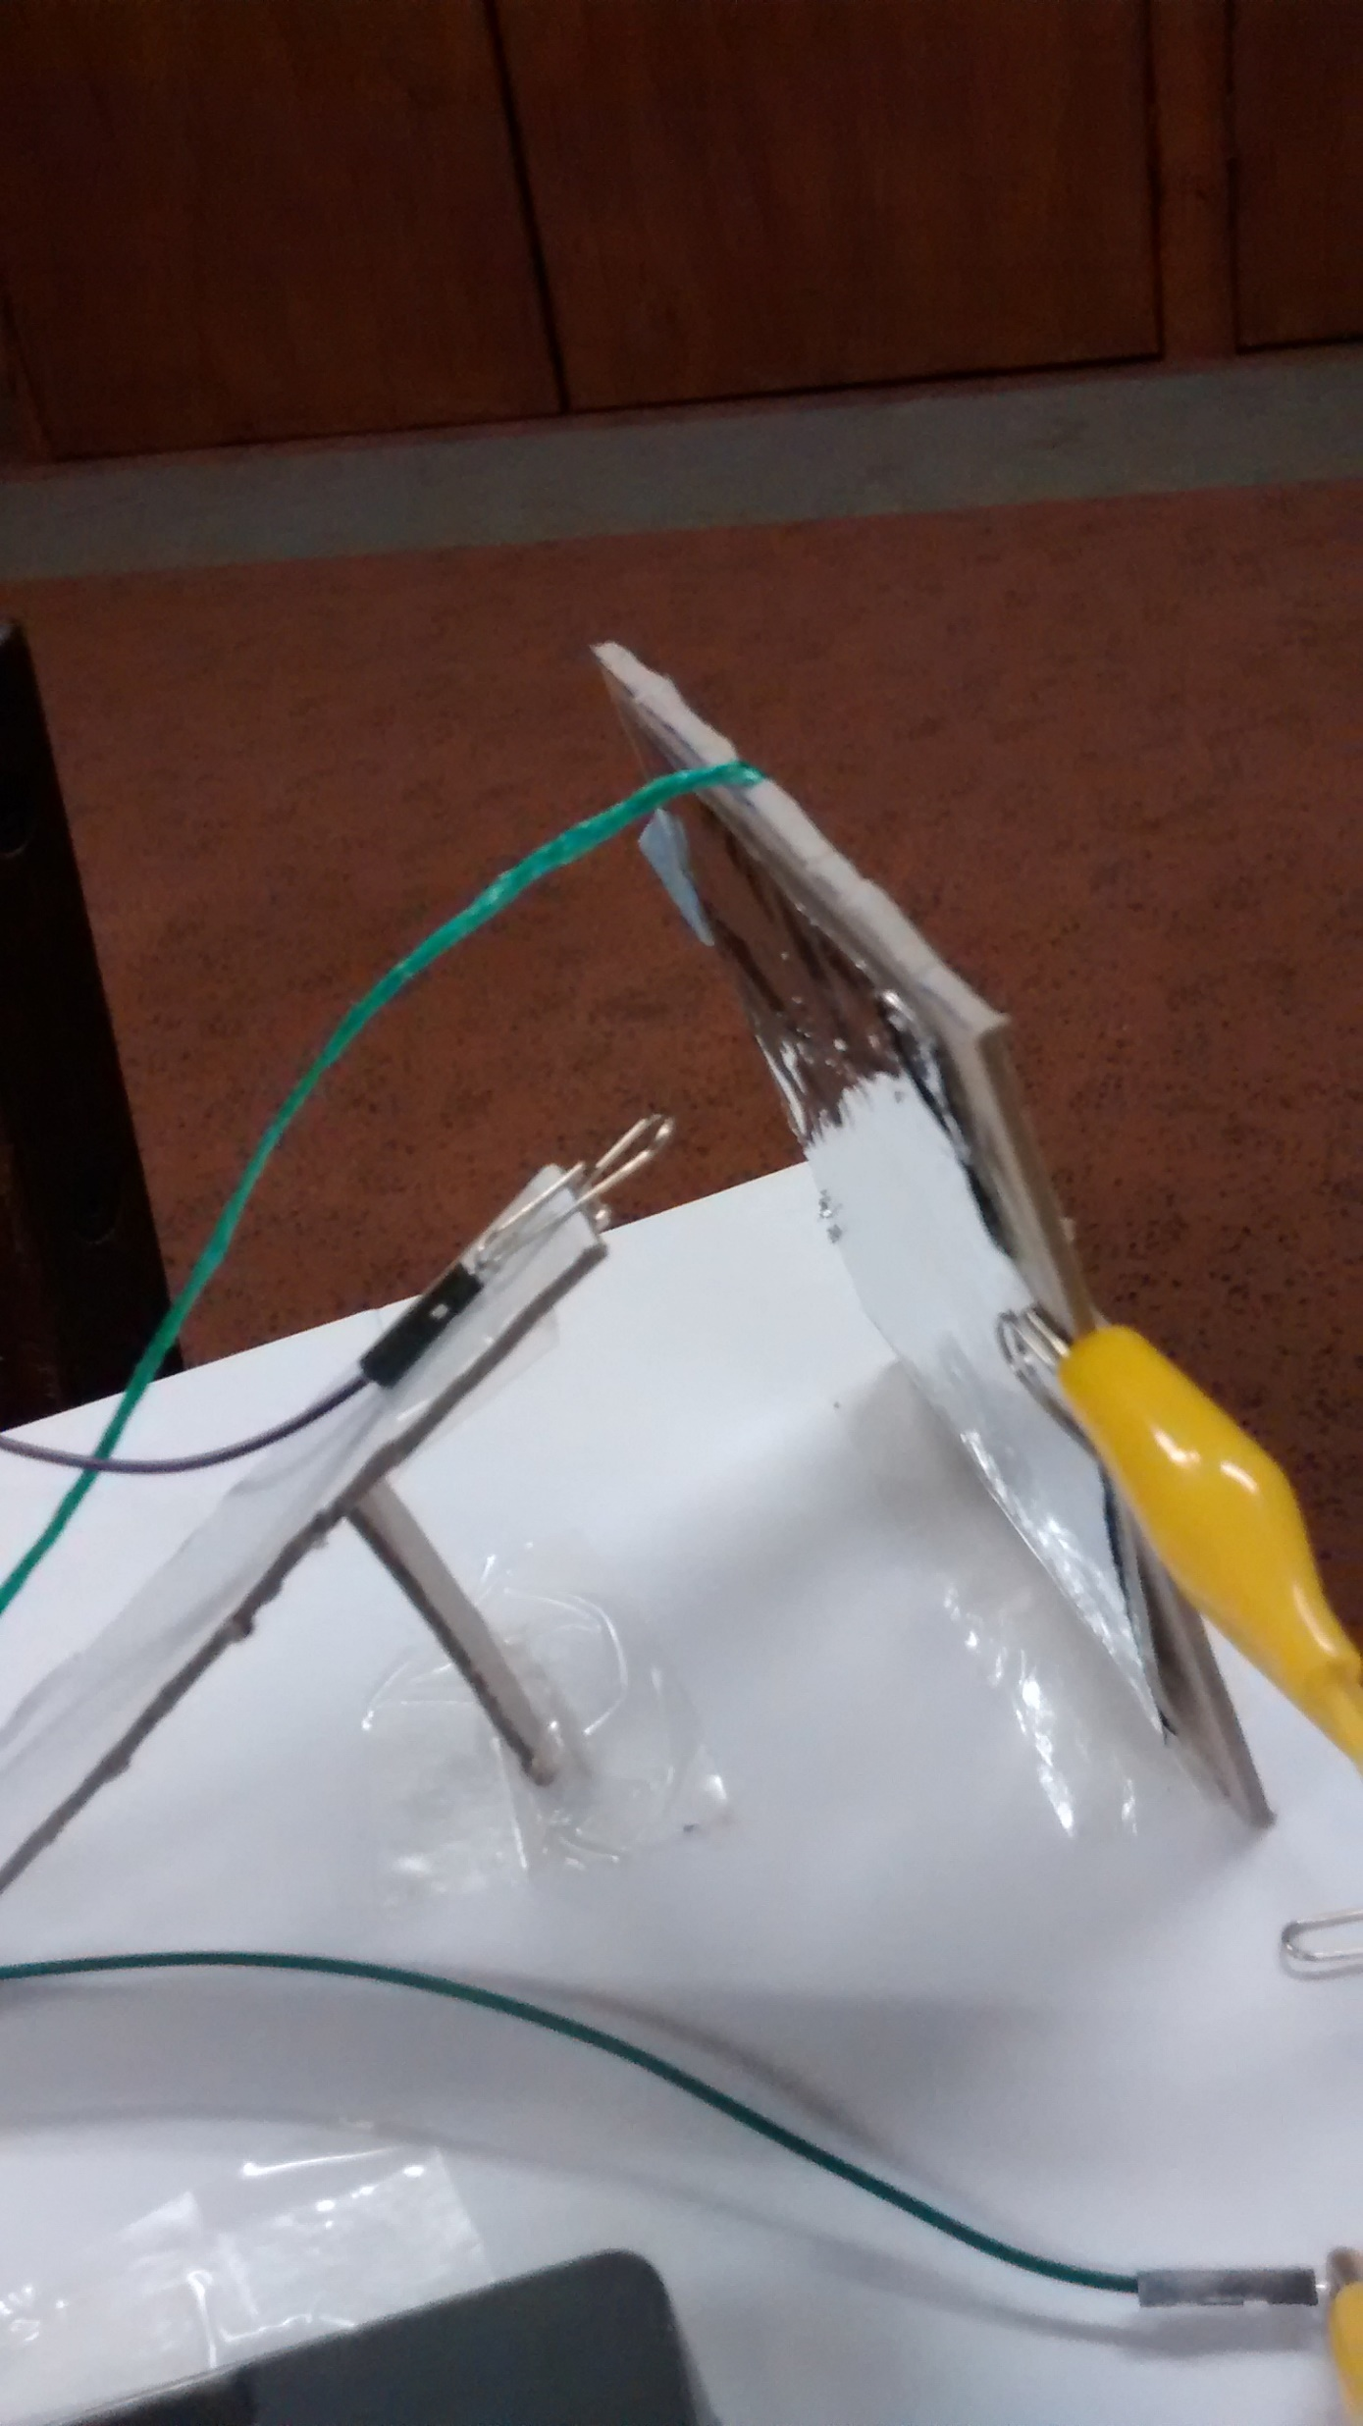
Notes:
Then, last year, we decided to do a simple activity involving three Raspberry Pis talking across the network: one controlling to a disc spinning on a wheel and sensing the Nerf dart hits on two sensor flaps; one starting and stopping the turntable; and the third receiving the scores and showing the scoreboard

Slide 9
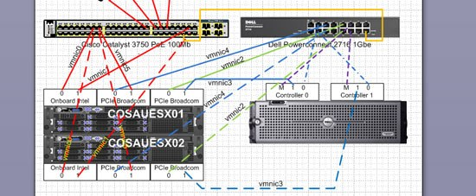
Notes:
We had three teams running over three weeks, with a one-hour session each week. I repurposed the zmq wrapper from the robot and gave the RPis static addresses. But each time the lads came in, we ended up with different addresses and so on, and there was a lot of "type *these* numbers in instead of *those* numbers" going on.

Slide 10
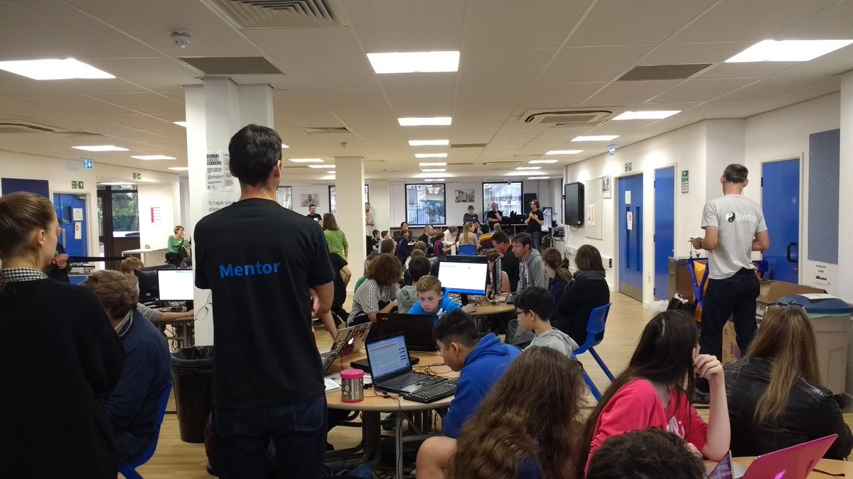
Notes:
So I thought: there are two things we need to do here which are particular to this kind of club situation -- and which would be similar in a CoderDojo or a classroom.

Slide 11

Notes:
have a simple way of discovering the other machine you're talking to;

Slide 12

Notes:
and b) have a straightforward pattern of sending messages and perhaps receiving answers.

Slide 13
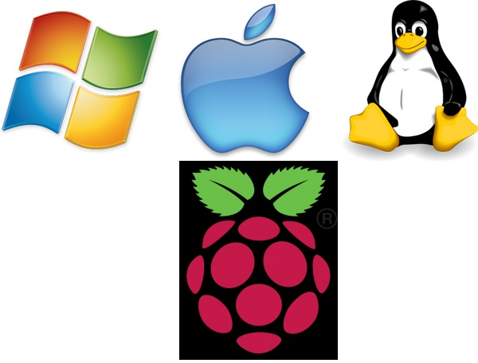
Notes:
and, ideally, have these work in a robust way cross-platform with at least Windows, Mac OS/X, Linux/RPi

Slide 14
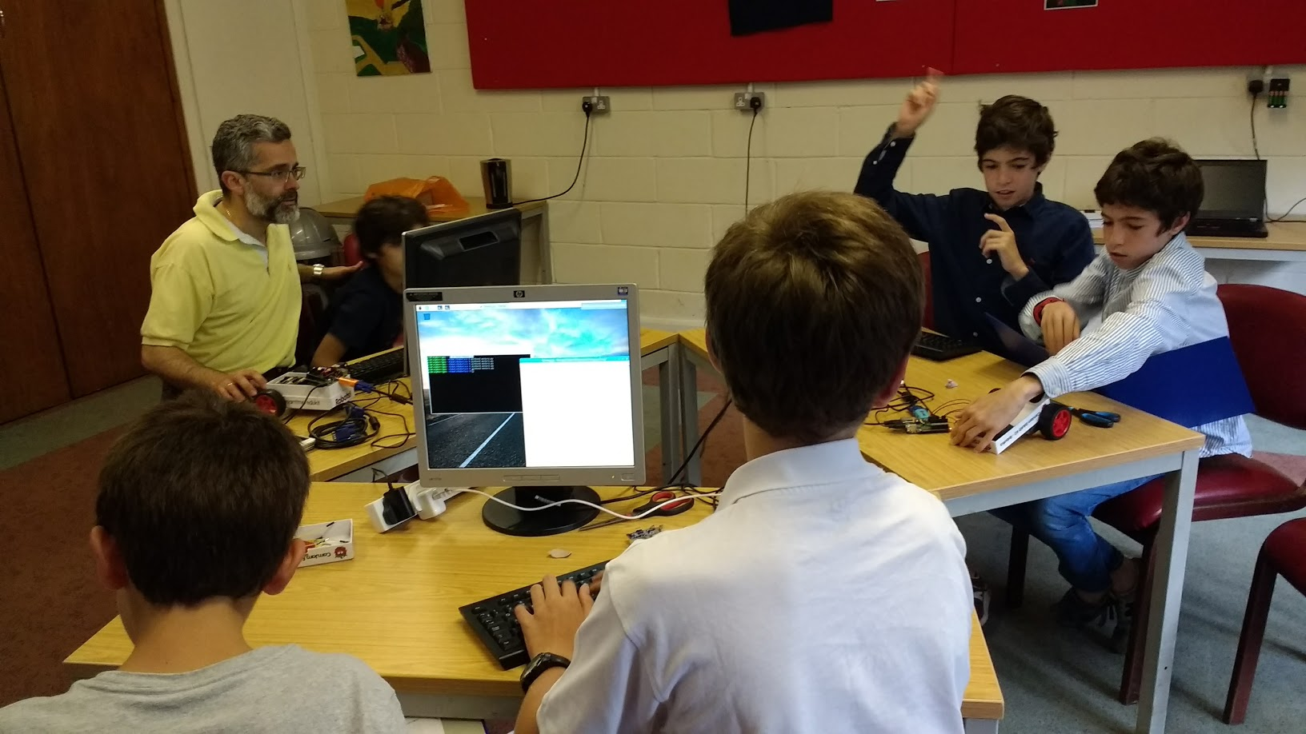
Notes:
Neither of these is a blindingly new problem; and the second already has some reasonable solutions -- including ZeroMQ itself, or even native sockets -- depending on how much pain you're prepared to put up with especially as you go cross-platform. But I'm focusing on the particular constraints of a tight timeframe and relatively inexperienced -- and probably young -- learners.

Slide 15
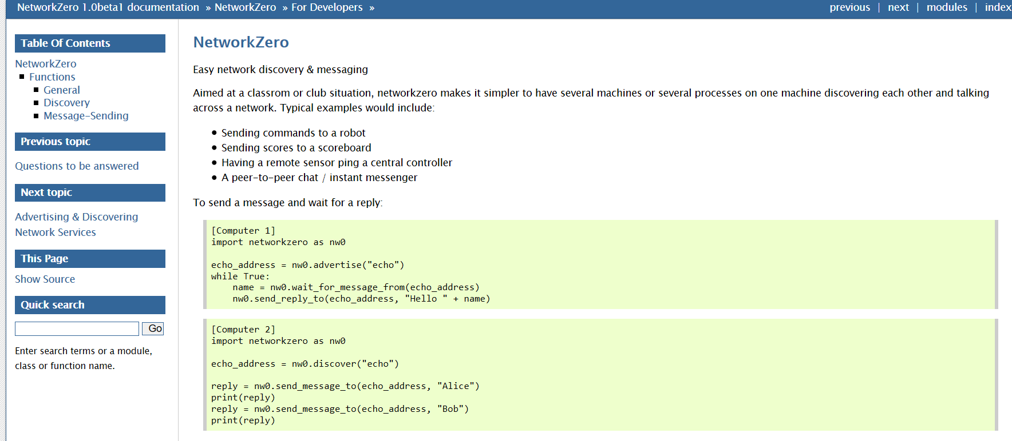
Notes:
So I created NetworkZero

Slide 16



GPIO Zero
PyGame Zero
GUI Zero
Notes:
The "Zero" suffix is in relation to the already existing PyGame Zero and GPIOZero (and there have been some more since including GUIZero). The idea is to make Python packages which are built on powerful libraries but which provide an easier entry point for beginners, typically by avoiding some noisy boilerplate which clutters what would otherwise be simple code.

Slide 17
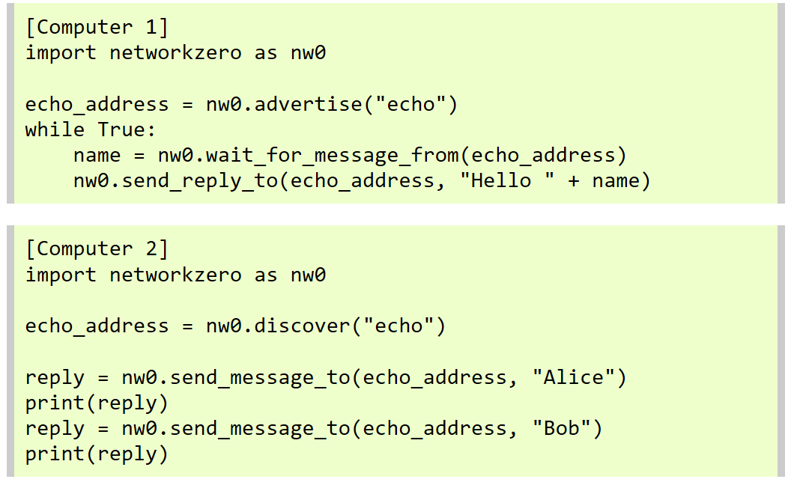
Notes:
How do you use networkzero [nw0]? In its simplest form, you obtain an address by advertising the name of a service and then you listen on that address for requests which you then act on and reply. Someone wanting to talk to your program will obtain an address by searching for the name of the service and will send a request to that address and receive a reply.

Slide 18

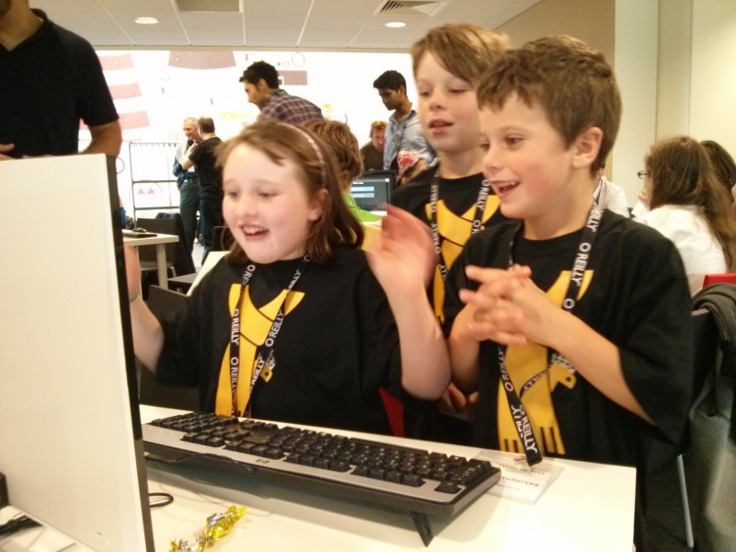
Notes:
And that's it. It actually does more than this, but this is the heart of networkzero: simple network code round which you can create a standalone program, or which you can use to sprinkle some network glitter on top of an existing project.

Slide 19
import networkzero as nw0
blink = nw0.discover(“blink”)
nw0.send_message_to(
blink,
(“<name>”, “RGBWRGBW”)
)
Notes:
Live Demo!

Slide 20

Notes:
What are its strengths?

Slide 21

Notes:
What are its weaknesses?

Slide 22
NetworkZero
Tim Golden @tjguk
https://github.com/tjguk/networkzero
http://networkzero.readthedocs.io/

